Slide 1
MODULE 5
INTEL SDC LIBRARY

Slide 2
CONTENTS
Introduction to Intel SDC library
Components of Intel SDC library
Enhancing Pandas performance
How Intel SDC library uses to improve the performance

Slide 3
Intel® Scalable Dataframe Compiler (Intel® SDC), which is an extension of Numba that enables the compilation of Pandas operations.
It automatically vectorizes and parallelizes the code by leveraging modern hardware instructions and by utilizing all available cores.
Intel® Scalable Dataframe Compiler (Intel® SDC) is a Python library that compiles data-intensive Python code into highly optimized, parallelized code for efficient execution on multi-core and many-core processors.
Intel® SDC uses the power of LLVM compiler infrastructure to optimize Python code and generate high-performance machine code for data-intensive operations on dataframes and arrays.

Slide 4
The library includes a collection of APIs for expressing data-intensive operations using a dataflow programming model, which enables the library to automatically parallelize and optimize code to take advantage of the underlying hardware architecture.
It provides transparent parallelism across multiple cores and nodes in a cluster and supports heterogeneous computing with CPUs, GPUs, and FPGAs.

Slide 5
Intel® SDC provides a transparent acceleration layer for popular Python data science libraries such as Pandas, NumPy, Scikit-learn, and XGBoost, allowing users to write code in a familiar and expressive Python API while achieving significant performance gains.
Intel® SDC is designed to work seamlessly with Intel® oneAPI, a comprehensive set of tools and libraries for developing high-performance, cross-architecture applications, enabling developers to optimize their data science applications for a wide range of hardware platforms.
Intel® SDC is available as an open-source library under the Apache License, Version 2.0, and can be downloaded from the Intel® SDC GitHub repository.

Slide 6
KEY COMPONENTS OF INTEL SDC LIBRARY
The SDC library includes a number of key components, including:
Dataflow APIs
Compiler
Runtime
Backend drivers
Distributed execution
Integration with oneAPI

Slide 7
Dataflow APIs
Intel® SDC provides a set of APIs for expressing data-intensive operations using a dataflow programming model.
The APIs support common data science operations such as filtering, sorting, aggregating, and joining dataframes, and enable Intel® SDC to automatically parallelize and optimize code to take advantage of multi-core and many-core processors.

Slide 8
Compiler
The heart of Intel® SDC is its compiler, which uses the LLVM compiler infrastructure to optimize Python code and generate high-performance machine code for data-intensive operations.
The compiler takes advantage of the dataflow programming model and the underlying hardware architecture to optimize and parallelize code for efficient execution.

Slide 9
Runtime
The runtime component of Intel® SDC provides a transparent acceleration layer for popular Python data science libraries such as Pandas, NumPy, Scikit-learn, and XGBoost.
The runtime optimizes code on the fly and transparently parallelizes and distributes computations across multiple cores and nodes in a cluster.

Slide 10
Backend drivers
Intel® SDC supports a wide range of hardware architectures, including CPUs, GPUs, and FPGAs.
Backend drivers provide the necessary low-level support for hardware-specific features and enable Intel® SDC to take advantage of hardware-specific optimizations.

Slide 11
Distributed execution
Intel® SDC supports distributed execution across multiple nodes in a cluster.
The distributed execution component provides transparent data and task parallelism, enabling users to scale their computations to handle large datasets.

Slide 12
Integration with oneAPI
Intel® SDC is part of the oneAPI family of tools and libraries for developing high-performance, cross-architecture applications.
Intel® SDC integrates seamlessly with other oneAPI tools, enabling developers to optimize their data science applications for a wide range of hardware platforms.

Slide 13
How to use intel SDC Library with Pandas
SDC is a technology developed by Intel that can accelerate the performance of Pandas by compiling Python code to machine code using Just-in-Time (JIT) compilation.
SDC can be used to speed up a variety of Pandas operations, including data filtering, aggregation, and sorting.

Slide 14
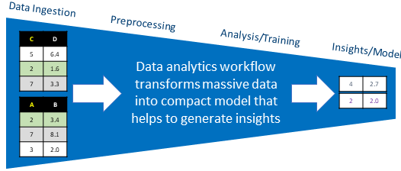
Common Work Flow
The workflow typically starts with reading data from a file (or multiple files) into a data frame (or multiple data frames) followed by data transformations of data frames and/or individual columns, cleaning the data, grouping and binning, and finally by feeding the cleaned data into machine learning algorithm for training or inference.

Slide 15
Installation
You can use conda and pip package managers to install Intel® SDC into your Python environment.
Intel SDC is available on the Anaconda Cloud intel/label/beta channel. Distribution includes Intel SDC for Python 3.6 and 3.7 for Windows and Linux platforms.
Intel SDC conda package can be installed using the steps below:
> conda create -n sdc_env python=<3.7 or 3.6>
> conda activate sdc_env
> conda install sdc -c intel/label/beta -c intel -c defaults -c conda-forge --override-channels

Slide 16

To use SDC with Pandas, you need to install the SDC package first.
You can do this using the following command:

Slide 17
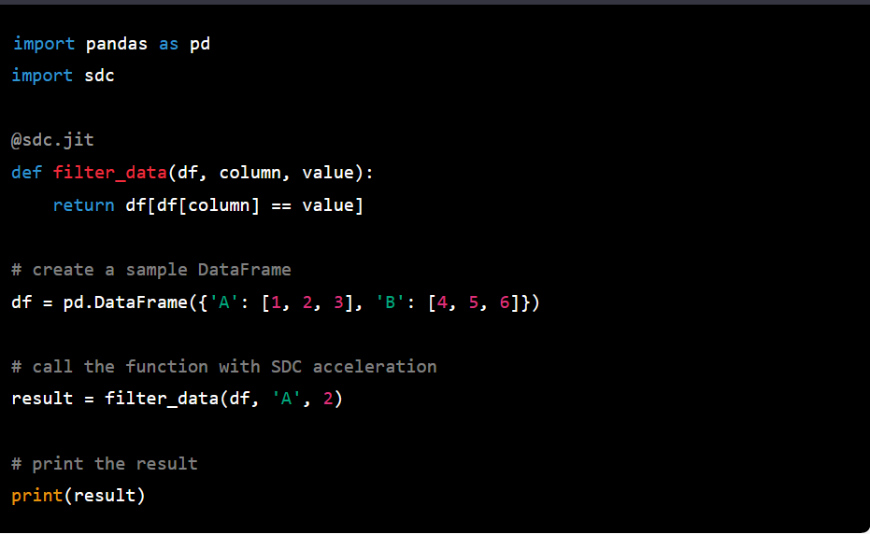
After installing SDC, you can use it by importing the sdc module and decorating your Pandas functions with the @sdc.jit decorator.
This decorator instructs SDC to compile the function to machine code for faster execution.

Slide 18
Getting Performance With Intel® SDC
Compiled code does not necessarily faster than interpreted one.
There are several key elements impacting whether compiled code will outperform an interpreted one or not.
These are compilation overheads, overheads related to converting Python objects to native structures and back, amount of parallelism in compiled code, to what extent the code is “static”, and many other factors.

Slide 19
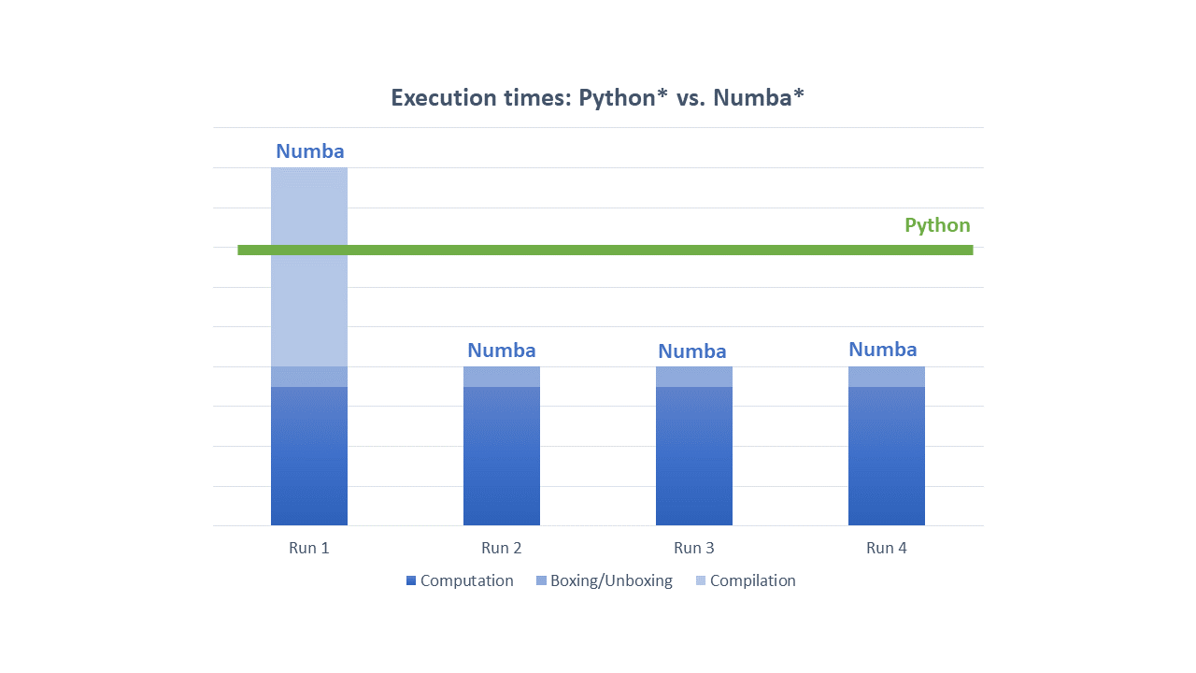
Performance can be evaluated using:
Compilation Overheads
Boxing And Unboxing Overheads
Automatic Parallelization

Slide 20
Compilation Overheads
Compilation of the code may lead to significantly better performance, however, it comes with some costs.
First, there is a cost associated with the need to compile a code.
Depending on the size of compiled function and many other factors the compilation time may be material.

Slide 21
General recommendations when compiling using Intel SDC
Compile application hotspots only.
Focus on where application spends most time.
Compile parts of the code where parallelism resides.
Remember that Intel SDC has been created to extract parallelism. If there is no parallelism in the code, then it unlikely to perform visibly better than interpreted code.

Slide 22
General recommendations when compiling using Intel SDC
3. Compilation overheads quickly become negligible when compiled function is called multiple times.
If arguments to compiled function are type stable then Numba won’t recompile the function on each call.
4. Use Numba caching for ahead-of-time compilation.

Slide 23
General recommendations when compiling using Intel SDC
5. Minimize the number of columns in data frames in a region being compiled.
Intel SDC performs data frame analysis at compilation time, as a result, the compilation may take significantly longer if the number of columns is large.
Among key features to reduce the number of columns in compile time analysis is to read in memory only columns actually used in computations.

Slide 24
Boxing And Unboxing Overheads
All Python objects are accessed through GIL, the Global Interpreter Lock, a mutex that protects Python objects preventing multiple threads from executing bytecodes concurrently.
While it is okay technology for interpreted code it kills any sort of parallelism. For Intel SDC and Numba to be able to extract parallelism, the GIL must be released.
To release GIL Python objects must be converted into native structures that do not require GIL.
The implication is additional overheads to convert input arguments into native objects (unboxing) and to convert results back to Python objects (boxing).

Slide 25
Automatic Parallelization
Intel SDC parallelizes most of Pandas operations so that users do not typically need to take extra steps besides using @njit decorator.
However, sometimes you might want to extract additional parallelism available in a JIT-region.
To do that you need to add parallel=True option to @njit decorator:

Slide 26
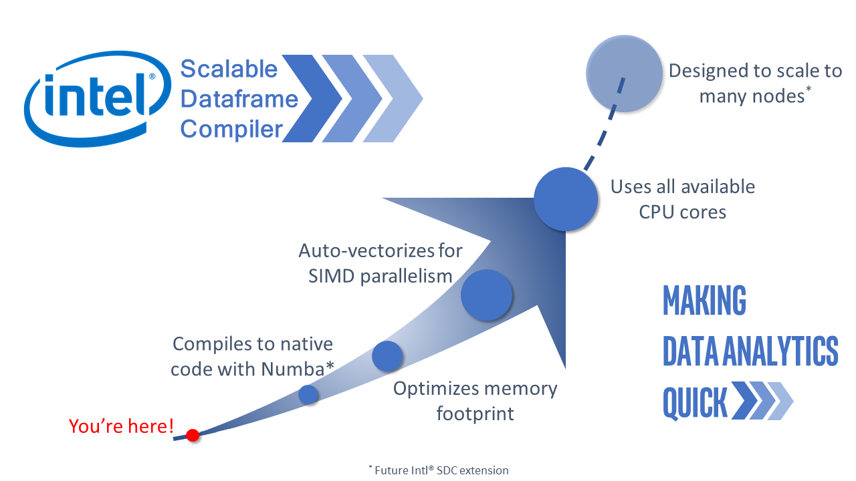

Slide 27
References
https://intelpython.github.io/sdc-doc/latest/index.html

Slide 28
THANK YOU

